Slide 1
Libraries, Contents, and Print
ST445

Slide 2
Learning objectives
Understand temporary vs. permanent libraries
Access .sas7bdat files by defining permanent library
Use PROC CONTENTS to investigate libraries and the descriptor portion of a data set
Use PROC PRINT to investigate the content portion of a data set
Explain the default output of PROC CONTENTS and PROC PRINT

Slide 3
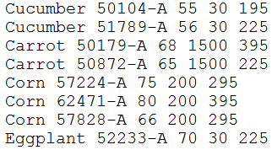
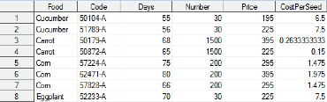
Temporary Library
data veg; *same as WORK.veg;
infile "S:\Documents\CURRENT COURSES\ST 445\Data\Veggies.txt";
input Food $ Code $ Days Number Price;
CostPerSeed = Price/Number;
run;
SAS data sets stored in a SAS library
Windows: collection of SAS files in the same physical directory
Default is WORK
Veg exists in this temporary library
Temporary → Files in current session only
Open SAS again? → Recreate data set!

Slide 4
Permanent Library
LIBNAME statement:
Global statement
Name: at most 8 characters long
Access SAS files?
Explorer window – view only
Programmatically – input in current program
Create SAS files?
Explorer window – drag & drop
Programmatically – output in current program
libname st445 "S:\Documents\CURRENT COURSES\ST 445\Data";
Library name
Directory (could be in double or singe quotes)

Slide 5
Using permanent libraries
Every SAS data set is identified by
Default Library Name is WORK
Two possible ways to put Veg in permanent library
Directly import to ST445 library, not WORK
<LIBRARY NAME>.<DATA NAME>
libname st445 "S:\Documents\CURRENT COURSES\ST 445\Data";
data st445.veg;
infile "S:\Documents\CURRENT COURSES\ST 445\Data\Veggies.txt";
input Food $ Code $ Days Number Price;
CostPerSeed = Price/Number;
run;

Slide 6
Using permanent libraries
Every SAS data set is identified by
Default Library Name is WORK
Two possible ways to put Veg in permanent library
Use SET statement after importing data to WORK
<LIBRARY NAME>.<DATA NAME>
data st445.veg;
set veg;
run;

Slide 7
Descriptor Portion?
Explorer tab?
Large data sets…
First proc!
Two forms of output
Output window (listing output)
Results Viewer will open up (HTML output)
New to SAS 9
Default in 9.3+
proc contents data = st445.veg;
run;

Slide 8
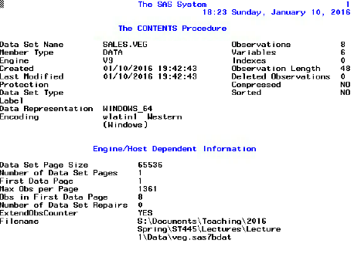
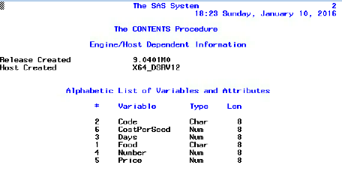
SAS output Window and list output
8 observations and 6 variables
Alphabetical order
Type (character or numeric) and Length (# bytes)
Other attributes if available (e.g. label)

Slide 9
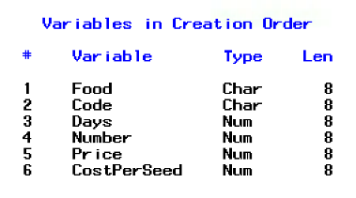
PROC CONTENTS: Variable Order
Use VARNUM option in CONTENTS statement
proc contents data = st445.veg varnum;
run;

Slide 10
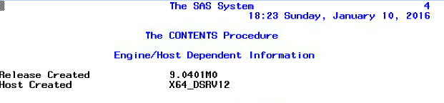
Headers and footers
Default: “The SAS System” & time and date
Create header or footnote with global statements:
TITLE “<text>”;
FOOTNOTE “<text>”;
Suppress Date and Page Numbers?
Another global statement!
OPTIONS <keywords>;
NODATE NONUMBER

Slide 11
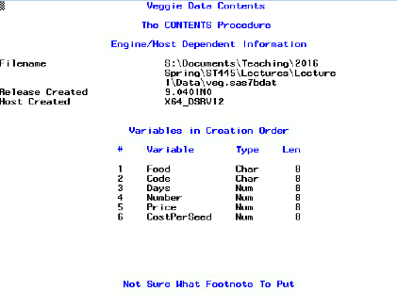
Headers and footers
Set a header and footer? → appear on every page
Change or clear it manually
Subtitles and subfootnotes?
TITLE2 – TITLE10 and FOOTNOTE2 – FOOTNOTE10
options nodate nonumber;
title "Veggie Data Contents";
footnote "Not Sure What Footnote To Put";
proc contents data = st445.veg varnum;
run;

Slide 12
Library summary
PROC CONTENTS can explore all data sets in library
If we run this code it will include
A summary of all data sets in the library
Descriptor information for all data sets
If we only want a summary of the data sets:
NODS → No descriptor
libname lecture2 "S:\Documents\CURRENT COURSES\ST 445\Lectures\Lecture 2\Data";
title "Collection of Data for Lecture 2";
footnote;
proc contents data = lecture2._all_;
run;
proc contents data = lecture2._all_ nods;
run;

Slide 13
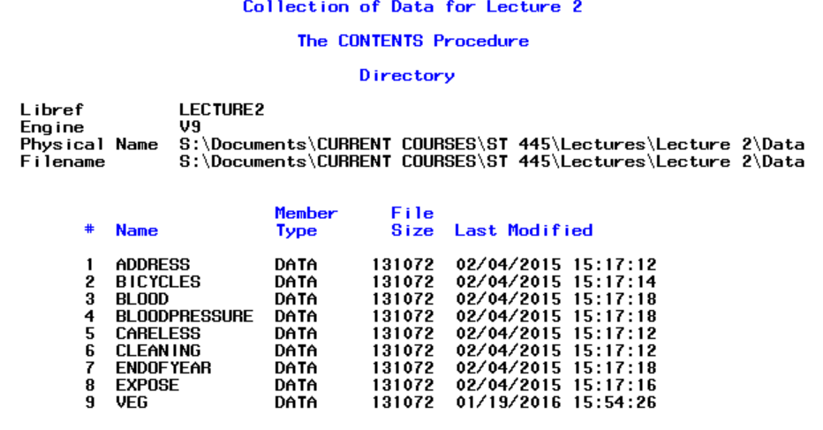
Library summary

Slide 14
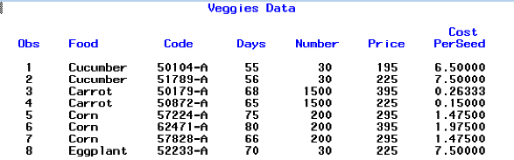
PROC PRINT
View content portion?
Explorer window → Interactive, non-programmatic
PROC PRINT → Static, programmatic
Adds OBS (observation) column by default
title "Veggies Data";
proc print data = lecture2.veg;
run;

Slide 15
PROC PRINT
Default output
All variables (in data set order) and observations
OBS column that labels the observations
Variables labeled with NAME attribute
Values output based on FORMAT attribute
Override defaults later…

Slide 16
In Class Assignment
Complete ICE #2
Submit assignment on Moodle

